Slide 1
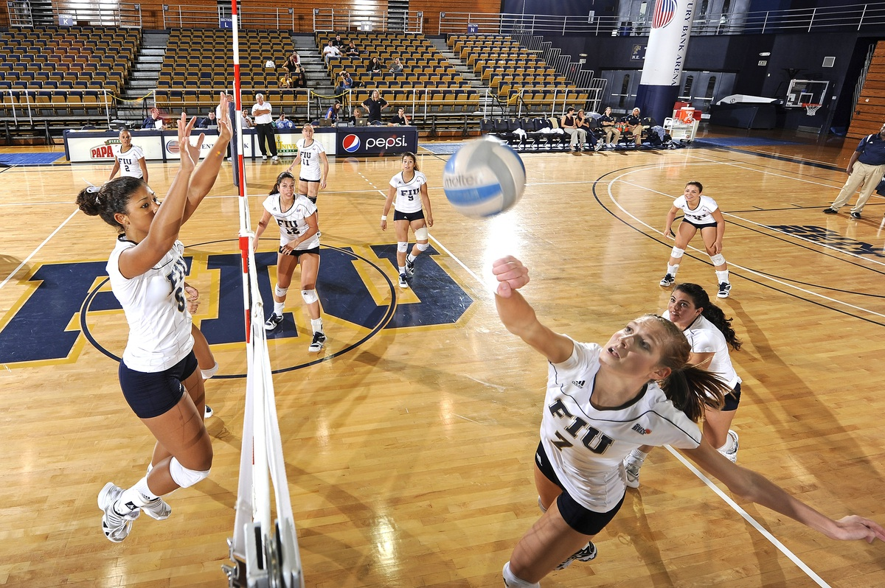
VOLLEYBALL
Lecturer: Ms Syeda Maryam Zahra
Department of Health & Physical Education
LCWU Lahore.
Email:maryamsyed565@gmail.com

Slide 2
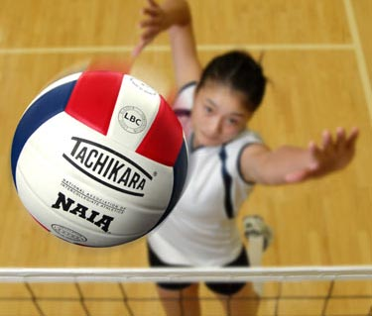
VOLLEYBALL
Volleyball is popular around the world.
Over 800 million people play this sport. Its great fun to play and exciting to watch. Volleyball is a team sport in which two teams of six players are separated by a net. Each team tries to score points by grounding a ball on the other team's court under organized rules. It has been a part of the official program of the Summer Olympic Games since 1964.
The complete rules are extensive, but simply, play proceeds as follows: a player on one of the teams begins a 'rally' by serving the ball (tossing or releasing it and then hitting it with a hand or arm), from behind the back boundary line of the court, over the net, and into the receiving team's court.

Slide 3
The rally continues, with each team allowed as many as three consecutive touches, until either
A team makes a kill, grounding the ball on the opponent's court and winning the rally.
A team commits a fault and loses the rally. The team that wins the rally is awarded a point and serves the ball to start the next rally.

Slide 4
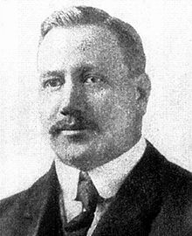
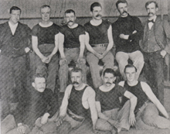
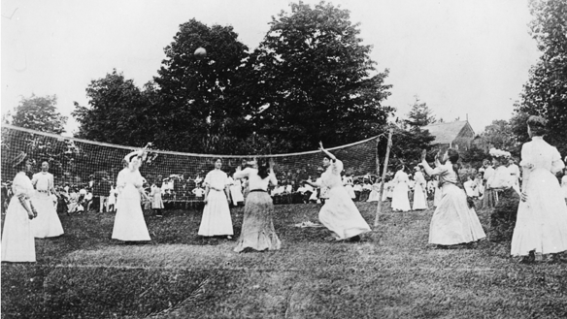
ORIGINS
1895, YMCA team in Massachusetts.
William Morgan is first left , second row.
The sport was invented in the U.S. by William G. Morgan in 1895.

Slide 5
History
History On February 9, 1895, in Holyoke, Massachusetts (USA), William G. Morgan, a YMCA physical education director, created a new game called Mintonette as a pastime to be played preferably indoors and by any number of players. The Fédération Internationale de Volleyball (FIVB), was founded in 1947, and the first World Championships were held in 1949 for men and 1952 for women. The sport was officially included in the program for the 1964 Summer Olympics. Beach volleyball, a variation of the game played on sand and with only two players per team, became a FIVB-endorsed variation in 1987 and was added to the Olympic program at the 1996 Summer Olympics. Volleyball is also a sport at the Paralympics managed by the World Organization Volleyball for Disabled

Slide 6
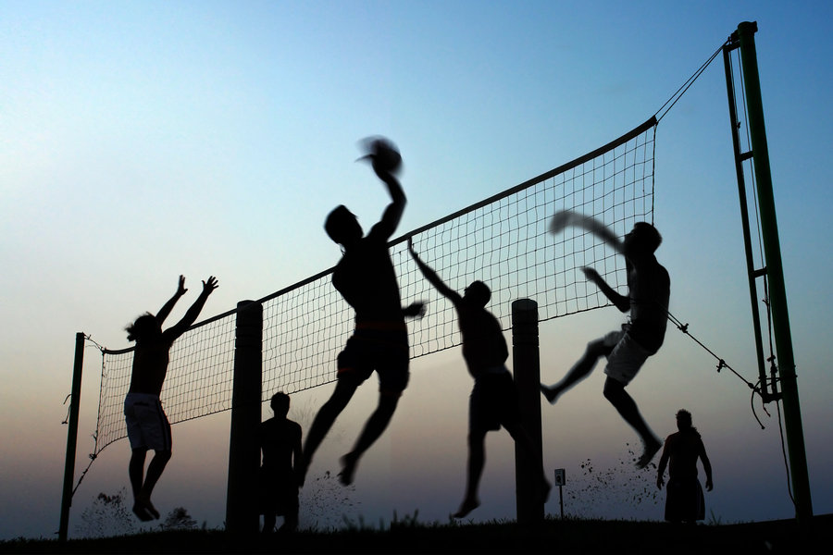
THE GAME
it is a game of two teams of six players separated by a net.

Slide 7
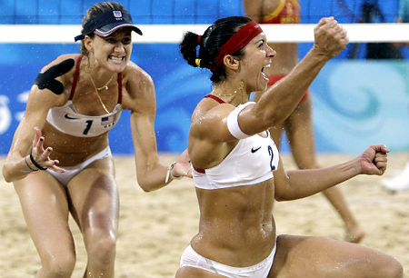
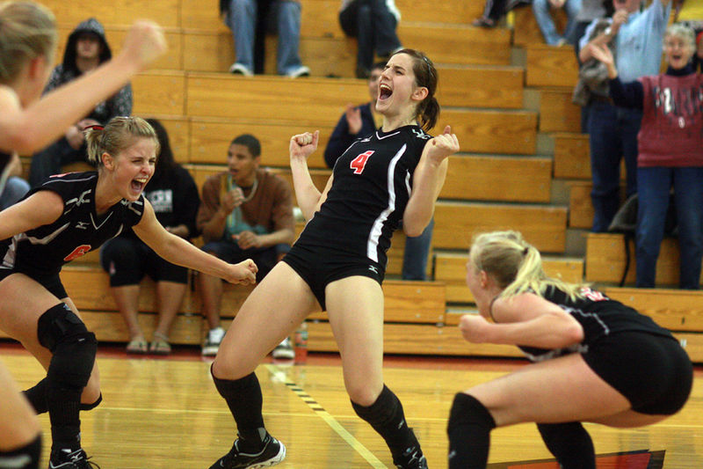
OBJECTIVE OF THE GAME
The goal is to be the first team to reach 25 in both games of the 2 set.

Slide 8
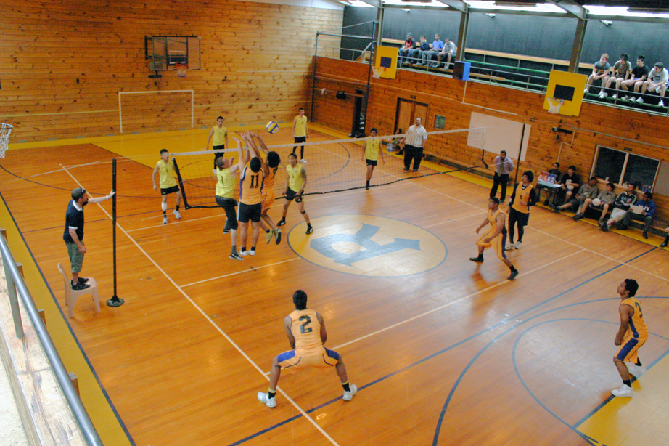
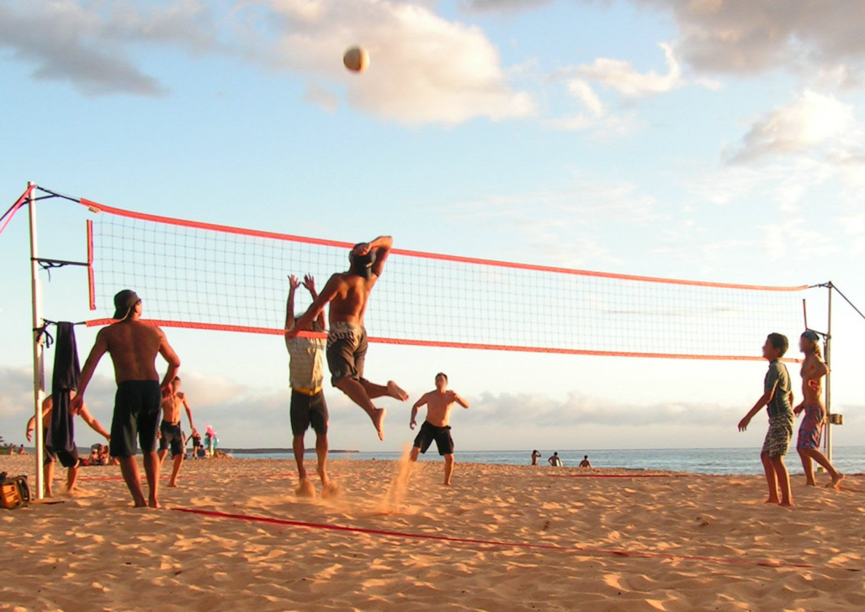
WHERE YOU CAN PLAY?
Inside: Gym
Outside: Beach

Slide 9
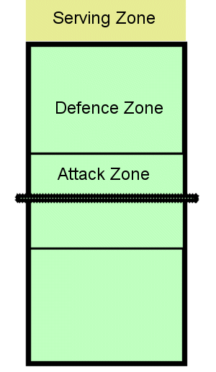
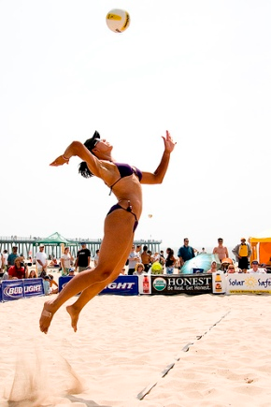
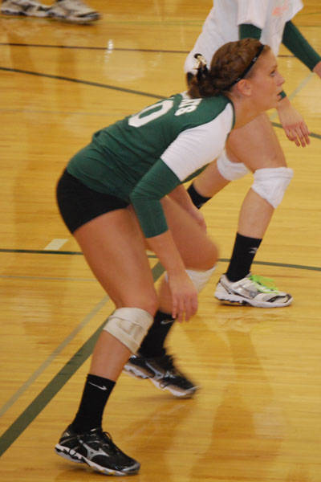
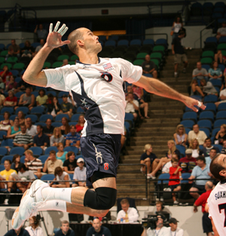
COURT AND POSITIONS
The court is divided in 2 equal parts.
In one part, there are a Serving Zone, Defense Zone and Attack Zone.

Slide 10
Volleyball Court

Slide 11
Court Dimensions
A volleyball court is 9 m × 18 m (29.5 ft × 59.1 ft), divided into equal square halves by a net with a width of one meter (39.4 in).
The top of the net is 2.43 m (7 ft 11 ¹¹⁄₁₆ in) above the center of the court for men's competition, and 2.24 m (7 ft 4 ³⁄₁₆ in) for women's competition, varied for veterans and junior competitions.
The minimum height clearance for indoor volleyball courts is 7 m (23.0 ft), although a clearance of 8 m (26.2 ft) is recommended.[A line 3 m (9.8 ft) from and parallel to the net is considered the "attack line".
This "3 meter" (or "10-foot") line divides the court into "back row" and "front row" areas (also back court and front court).[These are in turn divided into 3 areas each: these are numbered as follows, starting from area "1", which is the position of the serving player:

Slide 12
The players rotated like, clockwise.

Slide 13
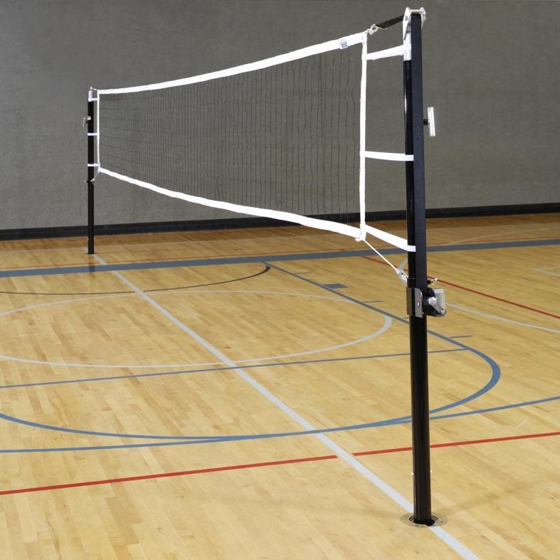
THE NET AND ROTATIONS
The volleyball net is 7 feet, 11 inches at its highest point for men, and is 7 feet, 4 inches for women. Height of the net: a. Men’s and coed competition — 2.43 meters (7 feet, 11 5/8 inches) b. Women’s competition — 2.24 meters (7 feet, 4 1/8 inches)

Slide 14
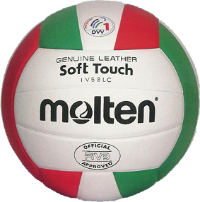
Ball
Circumference: 65 to 67 cm (25.5" to 27")
Weight: 260 to 280 grams (9 to 10 ounces)
Inside pressure: 0.30 to 0.325 kg/cm2 (4.3 to 4.6 lbs./sq. inch)

Slide 15
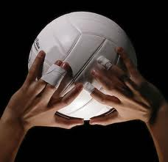
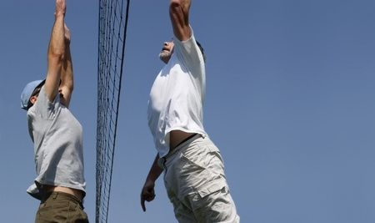
RULES IN VOLLEYBALL
There are a lot of rules, but the most important are:
The players can’t touch the net.
A single person can’t touch the ball two times consecutively.
The team is only allowed three touches.
The serve must start outside the court.
Blocking a serve isn’t allowed.

Slide 16
The result of a violation is a point for the opponent.
When serving, stepping on or across the service line as you make contact with the serve
Failure to serve the ball over the net successfully
Contacting the ball illegally (lifting, carrying, throwing, etc. )
Touching the net with any part of the body while the ball is in play. Exception: If the ball is driven into the net with such force that it causes the net to contact an opposing player, no foul will be called, and the ball shall continue to be in play.

Slide 17
When blocking a ball coming from the opponents court, contacting the ball when reaching over the net is a violation if both:
1) your opponent hasn't used 3 contacts 2) they have a player there to make a play on the ball
When attacking a ball coming from the opponents court, contacting the ball when reaching over the net is a violation if the ball hasn't yet broken the vertical plane of the net.
Crossing the court centerline with any part of your body. Exception: if its the hand or foot, the entire hand or entire foot must cross for it to be a violation.

Slide 18
Serving out of order.
Back row player blocking (deflecting a ball coming from their opponent), when at the moment of contact the back row player is near the net and has part of his/her body above the top of the net (an illegal block).
Back row player attacking a ball inside the front zone ( the area inside the 10 foot line), when at the moment of contact the ball is completely above the net (an illegal attack).

Slide 19
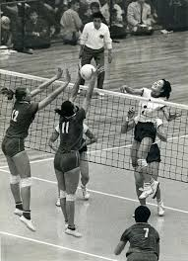
Volleyball in the Olympics
Volleyball has been part of the Summer Olympics program for both men and women consistently since 1964.

Slide 20
Faults
A few of the most common faults include:
causing the ball to touch the ground or floor outside the opponents' court or without first passing over the net.
catching and throwing the ball.
double hit: two consecutive contacts with the ball made by the same player.
four consecutive contacts with the ball made by the same team;
net foul: touching the net during play;
foot fault: the foot crosses over the boundary line when serving.
The ball is usually played with the hands or arms, but players can legally strike or push (short contact) the ball with any part of the body

Slide 21
Officials
As in most sporting competitions, volleyball employs referees in order to control the flow of the game and enforce the rules. The volleyball referee team includes the first referee, the second referee, the scorer and two line judges. Without the referee team, the fast-paced game could easily get out of hand if disputes regarding rules were to arise.

Slide 22
Scorers
The official scorer keeps track of the score throughout the volleyball game. Before the game begins the scorer notes the starting lineup of each team.
If a dispute or irregularity arises regarding the score, the scorer uses a buzzer to notify the first and second referees. Additionally, when a substitution request arises, the scorer notifies the referees.

Slide 23
Line Judges
At least two, and as many as four, line judges monitor each game. The line judges stand at the corners of the court watching the lines to indicate whether a ball in play falls in or out of the court.
If a server steps on the line during a serve, the line judge watching the given line notifies the referees using a flag. When a player touches an out-of-play ball or if the ball hits an antenna, the designated line judge also indicates the interference.

Slide 24
First Referee
The first referee stands on the referee stand and controls the play of the entire game. Whatever issues arise during the game, the first referee determines the call and the has the final say. After making a call, no player or other referee can argue the call, although a formal protest can be placed with the scorer.
Before the match begins, the first referee inspects the equipment and the players&#039; uniforms. The warm-ups and the coin toss also fall under the jurisdiction of the first referee.
Throughout the match, the first referee makes calls regarding faults and scoring issues. Following the match, the first referee notes the score and signs the official paperwork.

Slide 25
Second Referee
The second referee works to assist the first referee throughout the game. If for some reason the first referee can&#039;t finish her duties, the second referee may take the place of the first referee.
The second referee stands next to the post opposite the first referee. In addition to assisting the first referee with determining faults throughout the game, the second referee is in charge of all substitutions, timeouts and the actions of the scorer

